Slide 1
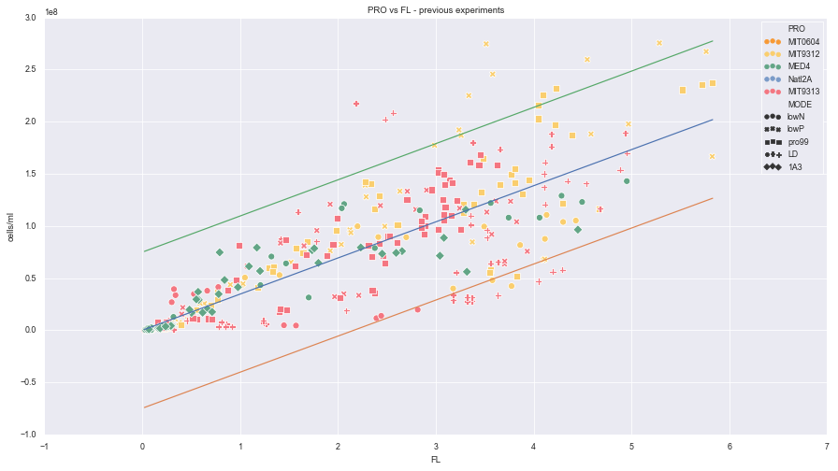
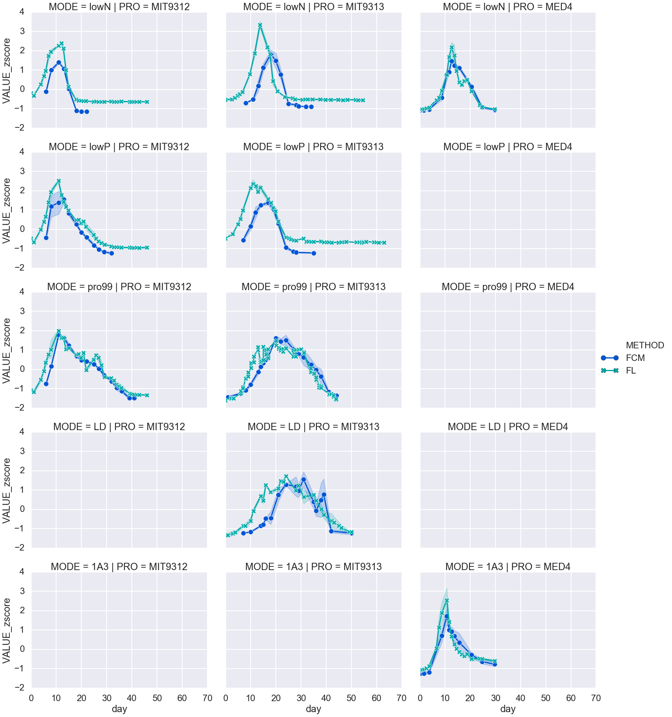
Figure 1S: correlation between FL and PRO cell counts
OLS Regression Results
=======================================================================================
Dep. Variable: FCM R-squared (uncentered): 0.849
Model: OLS Adj. R-squared (uncentered): 0.849
Method: Least Squares F-statistic: 1935.
Date: Tue, 10 Mar 2020 Prob (F-statistic): 4.53e-143
Time: 19:11:52 Log-Likelihood: -6491.9
No. Observations: 344 AIC: 1.299e+04
Df Residuals: 343 BIC: 1.299e+04
Df Model: 1
Covariance Type: nonrobust
==============================================================================
coef std err t P>|t| [0.025 0.975]
------------------------------------------------------------------------------
FL 3.464e+07 7.88e+05 43.987 0.000 3.31e+07 3.62e+07
==============================================================================
Omnibus: 22.969 Durbin-Watson: 0.978
Prob(Omnibus): 0.000 Jarque-Bera (JB): 53.226
Skew: 0.308 Prob(JB): 2.77e-12
Kurtosis: 4.826 Cond. No. 1.00
==============================================================================
Warnings:
[1] Standard Errors assume that the covariance matrix of the errors is correctly specified.

Slide 2
Figure s2

